Slide 1
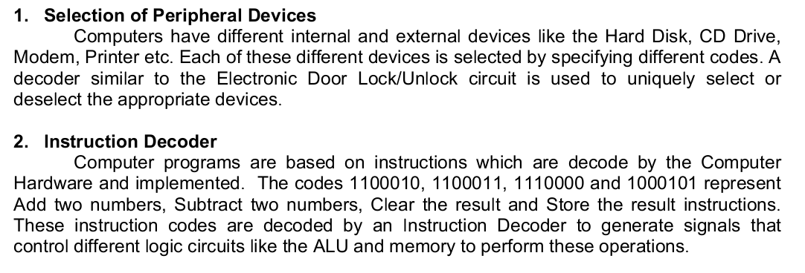
DECODER
A decoder is a circuit that converts binary information from
the n coded inputs to a maximum of 2^{n} unique outputs
Multiple Inputs and Multiple Outputs

Slide 2
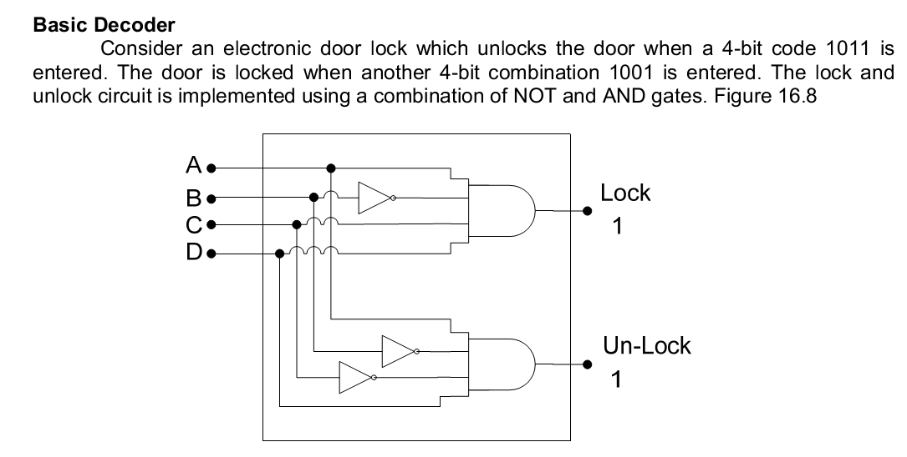

Slide 3
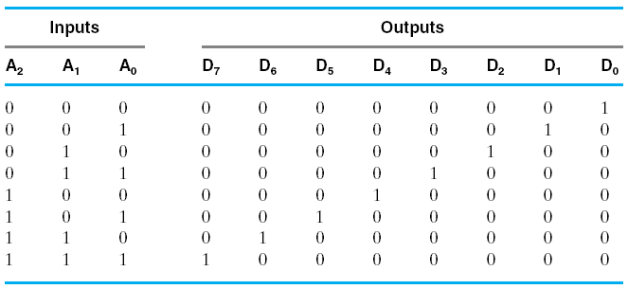
Example: 3 to 8 line decoder

Slide 4
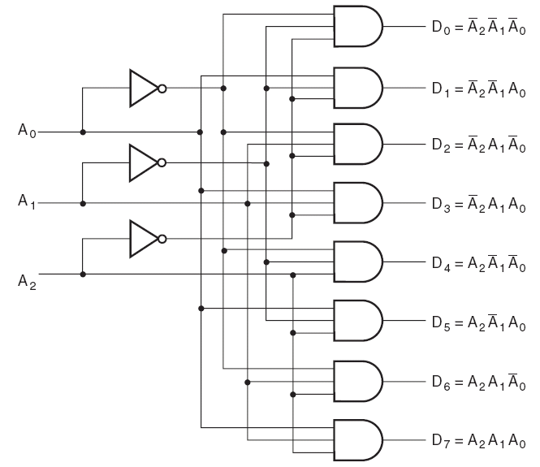
DECODERS

Slide 5
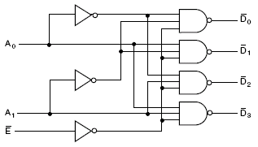


DECODER
Example: 2 to 4 line decoder

Slide 6
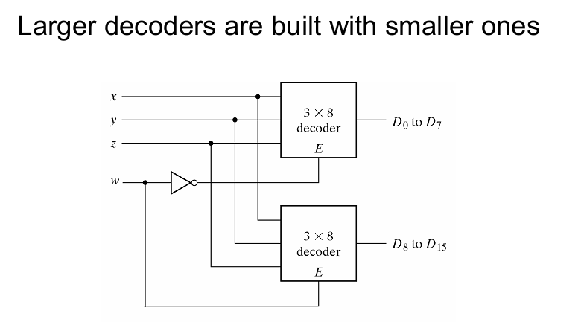
LARGE DECODERS

Slide 7
Function Implementation via Decoder
Full Adder
Input |  |  | Output
A | B | Carry In (C) | Sum | Carry Out
0 | 0 | 0 | 0 | 0
0 | 0 | 1 | 1 | 0
0 | 1 | 0 | 1 | 0
0 | 1 | 1 | 0 | 1
1 | 0 | 0 | 1 | 0
1 | 0 | 1 | 0 | 1
1 | 1 | 0 | 0 | 1
1 | 1 | 1 | 1 | 1

Slide 8

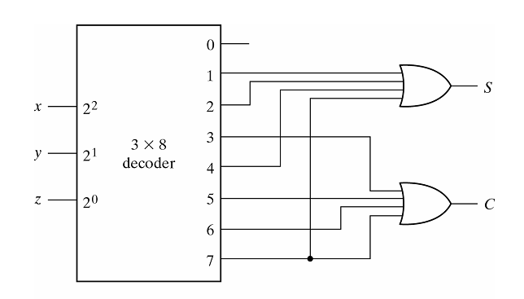

Slide 9
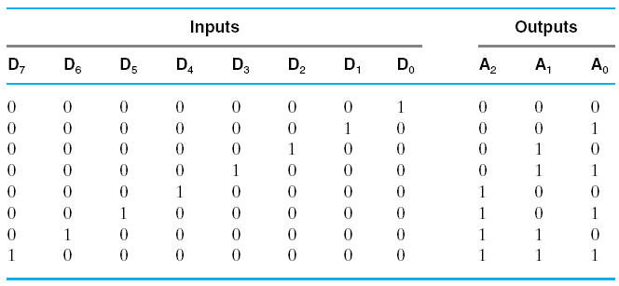
ENCODERS
An encoder has 2^{n} or fewer input lines and n output values
Opposite of the decoder function
The output lines generate the binary code corresponding to
the input value
A2=D4+D5+D6+D7;
A1=D2+D3+D6+D7;
A0=D1+D3+D5+D7
Example:

Slide 10
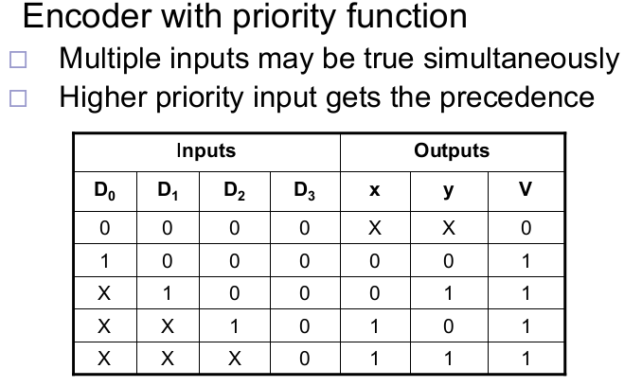
ENCODERS
Priority Encoder
The operation of the priority encoder is such that if two or
more inputs are equal to 1 at the same time, the inputs
having the highest priority takes precedence
Example: A four input priority encoder

Slide 11
ENCODERS
Priority Encoder
The Xs in output columns represent don’t care conditions
The Xs in input columns are used to represent both 1s and 0s
The output V (V for valid) is set to 1 only when one or more
inputs are equal to 1
If all inputs are equal to 0, then V is set to 0

Slide 12
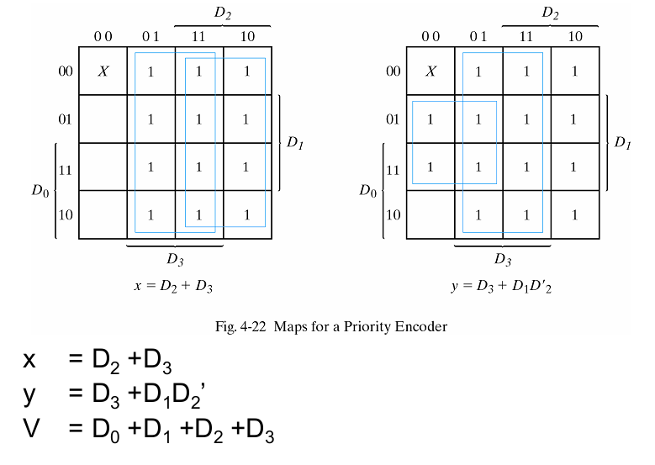

Slide 13
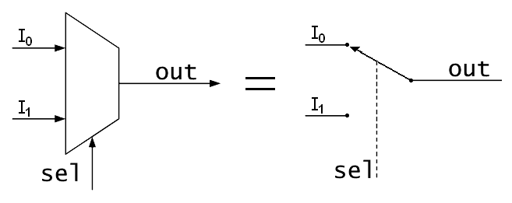
MULTIPLEXERS
a multiplexer selects one of several input signals
and forwards the selected input into a single line
n inputs, one output and s select inputs (2^s = n)

Slide 14
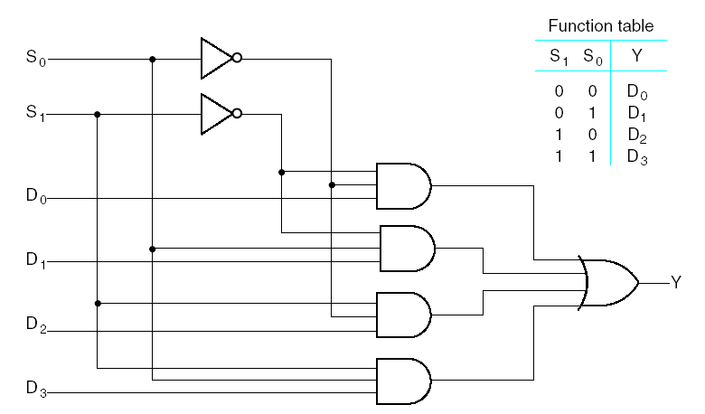
MULTIPLEXERS
Selection Inputs: Input variables which control the selection of
input lines. For 2^{n} input lines we need n selection inputs
An 2^{n} input, m output multiplexer is called 2^{n}-to-m line MUX
A 4-to-1 line MUX is shown above

Slide 15
MULTIPLEXERS
Enable Input
An enable input controls the operation of the unit
It is useful for combining two or more multiplexers into a
single large multiplexer
Multiple Bits Selection
Multiplexer blocks can be combined in parallel to perform
selection on multiple bit quantities
These have common selection and enable lines

Slide 16
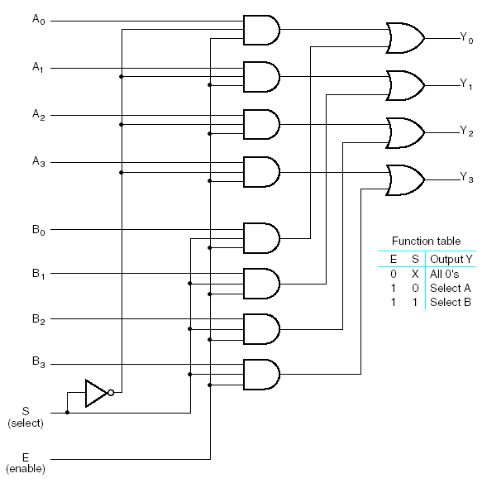
MULTIPLEXERS
Quadruple
2-to-1 line MUX
It has 4 multiplexers
each capable of
selecting one of two
input lines
The circuit may also
be viewed as a
selector of one of two
sets of data lines,
where each set has
4 lines

Slide 17
MULTIPLEXERS
Selection Inputs: Input variables which control the selection of
input lines. For 2^{n} input lines we need n selection inputs
An 2^{n} input, m output multiplexer is called 2^{n}-to-m line MUX
A 4-to-1 line MUX is shown above

Slide 18
MULTIPLEXERS
Boolean Function Implementation
We can implement a Boolean function of n variables with a
multiplexer with n-1 selection inputs
The first n-1 variables of the function are connected to the
selection inputs of the multiplexer and the remaining
n^{th} variable is used for data inputs

Slide 19
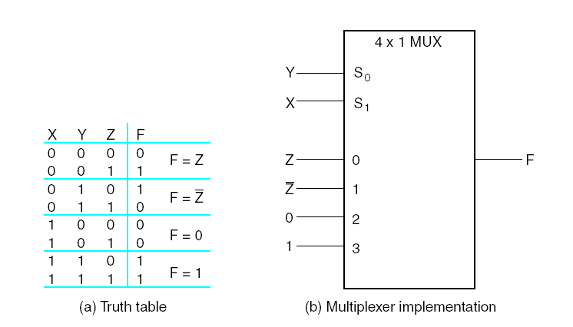
MULTIPLEXERS
Boolean Function Implementation
F = Σm(1,2,6,7)

Slide 20
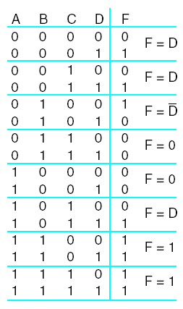
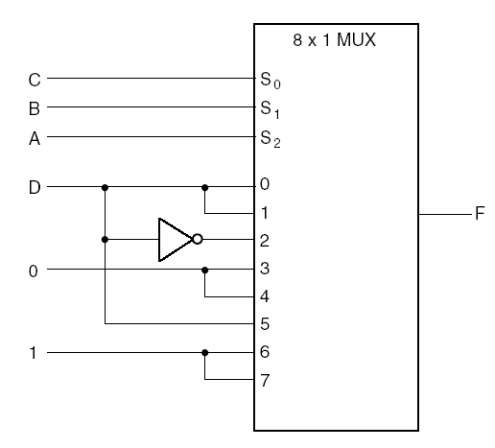
MULTIPLEXERS
Boolean Function Implementation
F = Σm(1,3,4,11,12,13,14,15)

Slide 21
MULTIPLEXERS
Boolean Function Implementation
F = Σm(2,3,5,6,8,9,12,14)

Slide 22
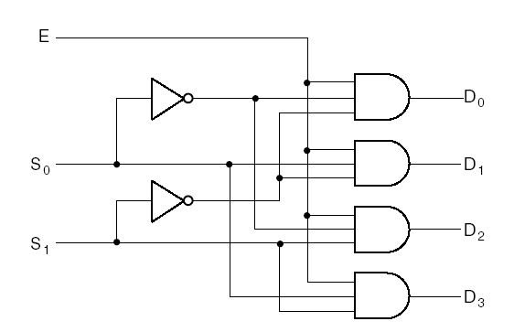
MULTIPLEXERS
Demultiplexers
A demultiplexer receives information from a single line and
transmits it to one of 2^{n} output lines
A 1-to-4 line demultiplexer:

